Slide 1


PROJECT: NeuroAI / Comparing Networks
2025
Probing Motor Learning in Embodied Neural Networks
Presented by
Team VPN
Notes:
hello everyone, i am byron from Team VPN and the title for our project is P___ks

Slide 2
Background Info
PROBLEM
READ
Selected Tasks
Exploring links between Neuroscience theories and artificial neural dynamics for robust AI applications
Do artificial neural networks trained for a task actually compute like the brain—or do they just look similar on the surface?
Run
Comparing Networks Notebook for 3BFF example
*Q1, 2, 3, 4)
Review literature related to MotorNet Paper and DSA
Question 5, 6, 7, 10
MOTIVATION
ANALYZE
NMA Comparing Networks
Page 02/20
Notes:
We're investigating if artificial neural networks mimic brain processes or just appear similar, which is key for robust AI development. Our goal is to find connections between neuroscience and AI dynamics to build reliable AI systems.

Slide 3
Q
CAN WE TRAIN AN RNN TO CONTROL AN ARM FOR REACHING A RANDOM TARGET?
Overview
Q
WHAT ARE THE LATENT TRAJECTORIES?
Q
CAN THE RNN PERFORM WELL IN A NOVEL ENVIRONMENT?
Notes:
here are the questions

Slide 4
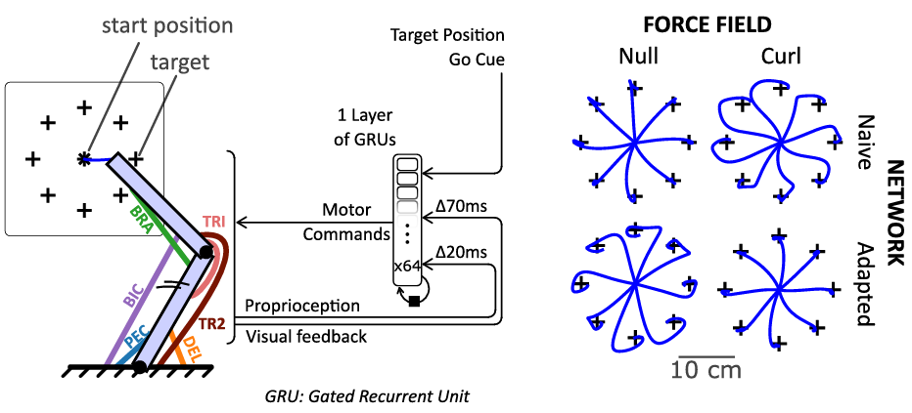
MotorNet Setup
Musculoskeletal arm schematic
Random-Target (RT) workspace grid
NMA Comparing Networks
Page 04/20
Notes:
On the left, there's a 2D biomechanical arm model with 26 Hill-type muscles, controlled by a GRU network which gets delayed visual and proprioceptive feedback.
On the right, the Random Target workspace features episodes with random target locations in a 2D grid. The agent, starting from a fixed posture, must reach the target.

Slide 5
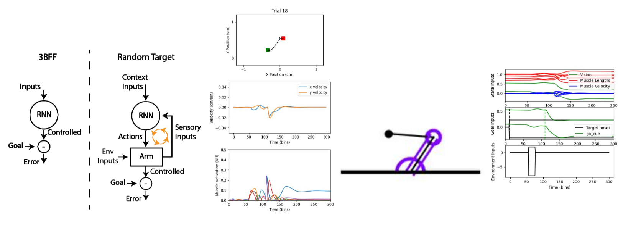

Network Architecture
01
Input Layer - Observation
02
GRU → Linear → Sigmoid
03
Output - Muscle Activation
NMA Comparing Networks
Page 05/20
Notes:
here is the model, which centered on a GRU, takes context and sensory inputs to guide the arm's actions. The arm finally minimize position error and reach the target.

Slide 6
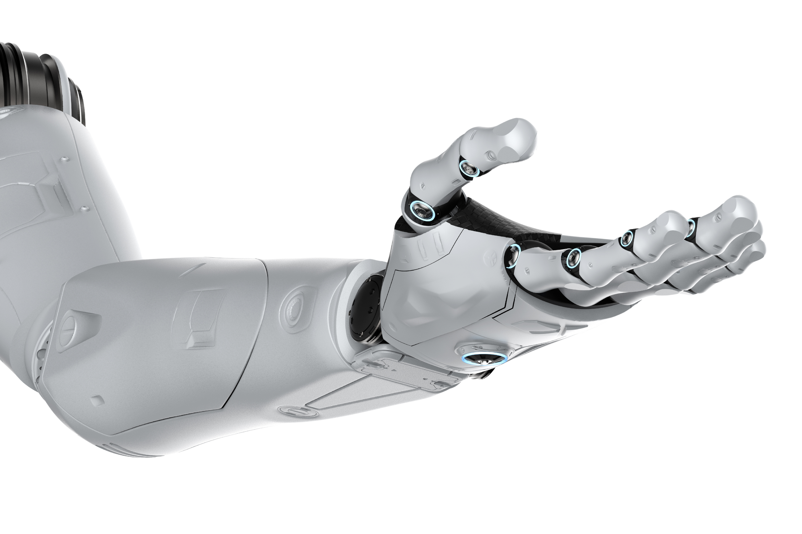
Can we train an RNN to control an arm for reaching a random target?
NMA Comparing Networks
Q5 FROM THE TEMPLATE ON NMA

Slide 7
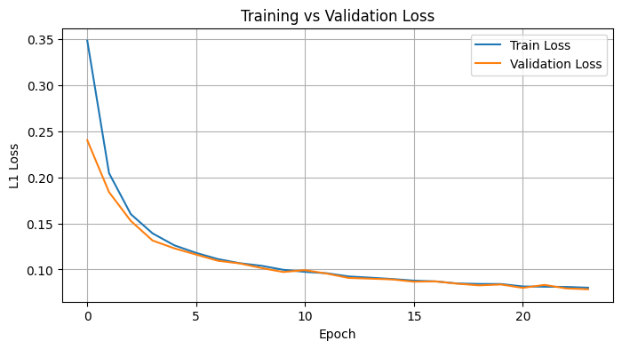
Training Curves
Train/Val loss per epoch
NMA Comparing Networks
Page 07/20

Slide 8
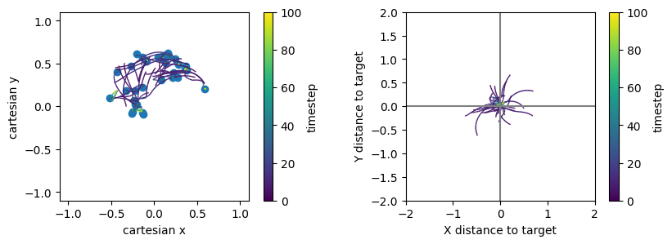
Model Evaluation
Max final error: 0.078
NMA Comparing Networks
Page 08/20

Slide 9
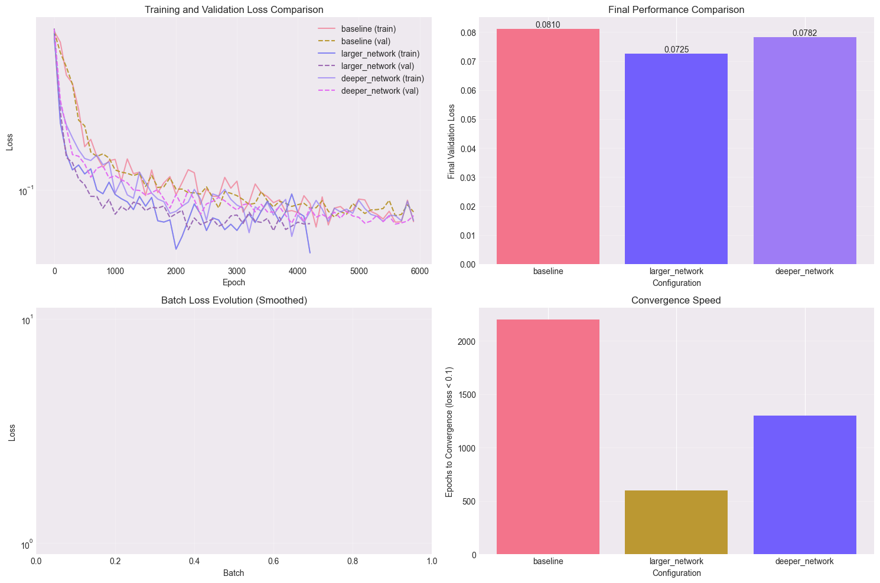
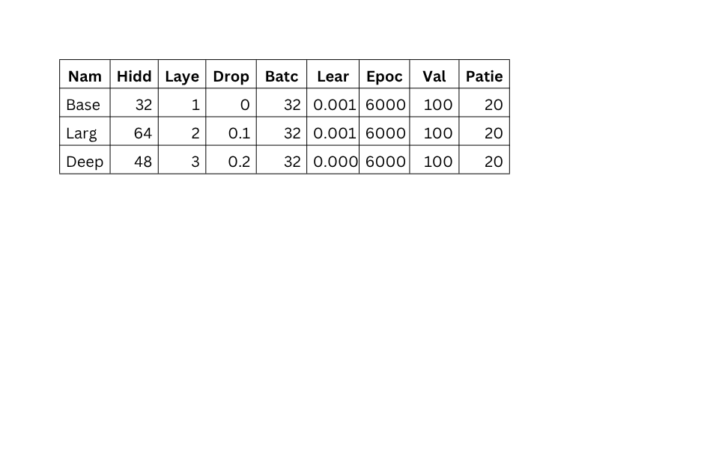
3 Model Comparison
We compared 3 different model complexities: DEEPER & LARGER, however our simple baseline model seemed to perform the best.
NMA Comparing Networks
Page 09/20
Notes:
We compared 3 different model complexities, varying the number of layers, nodes etc however our simple baseline model seemed to perform the best.

Slide 10
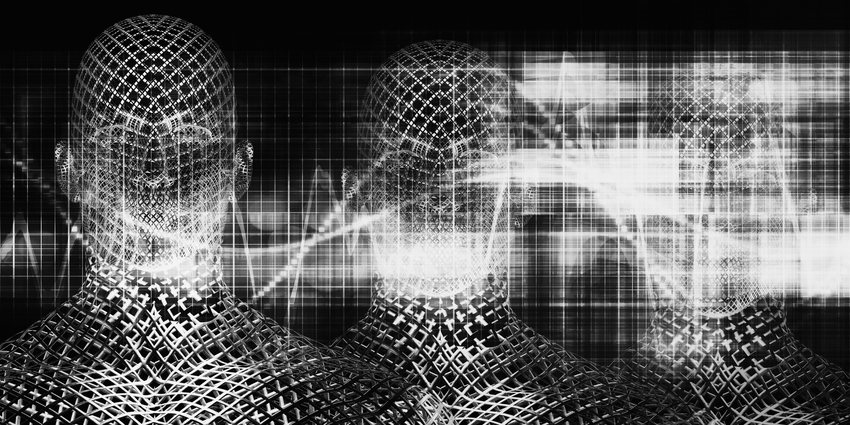
Latent Visualization
NMA Comparing Networks
Q6 FROM THE TEMPLATE ON NMA

Slide 11
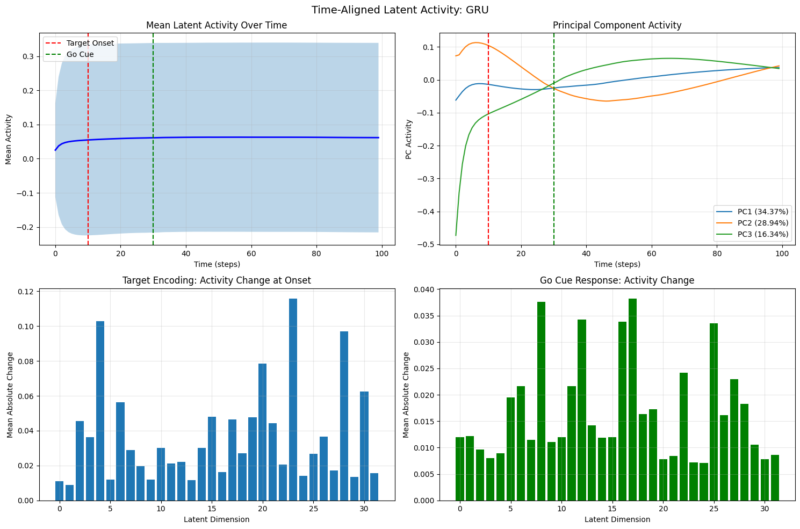
Latent Trajectories
🔵 Top-Left: Mean Latent Activity Over Time
After the target onset, the GRU's mean activity rises slightly and then stabilizes, reflecting early task encoding followed by stable control dynamics.
🔵 Top-Right: Principal Component Activity
The first three principal components show structured, low-dimensional temporal evolution, with clear shifts aligned to target onset and the go cue.
NMA Comparing Networks
Page 11/20
Notes:
“We analyzed the GRU’s internal activity to understand how the model encodes task structure.
On the left, we plot the mean latent activity over time. Right after target onset (red line), we see a slight increase in activity that likely reflects initial processing of the target and then stable dynamics during execution.
On the right, we run PCA on the GRU activations. The first three principal components explain most of the variance and show clear temporal structure: they shift right after the target and again at the go cue (green line), capturing how the network transitions between different control phases.

Slide 12
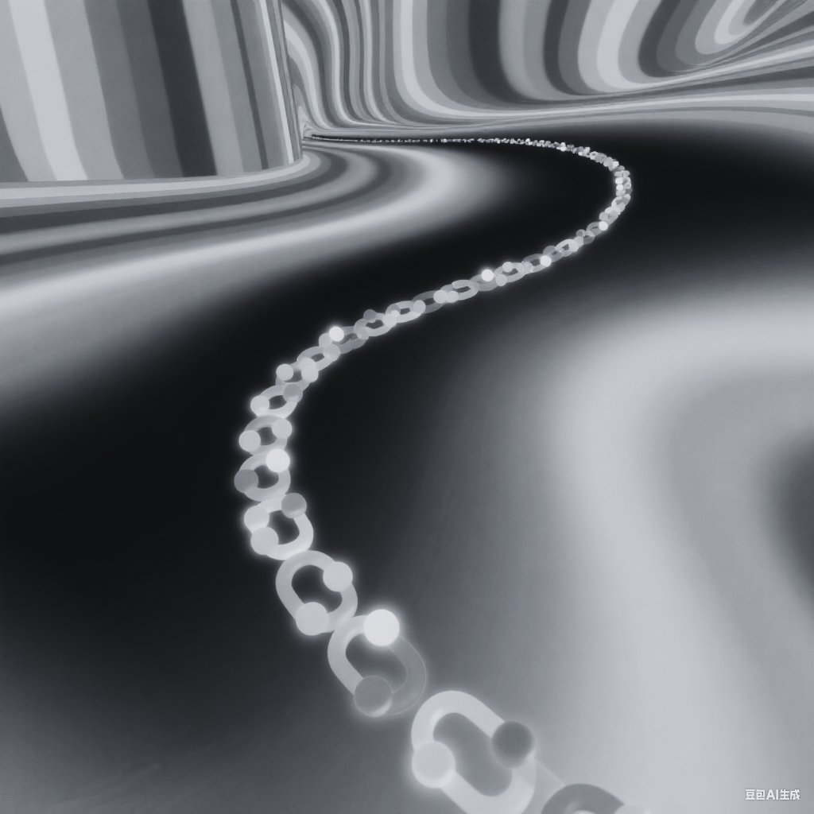
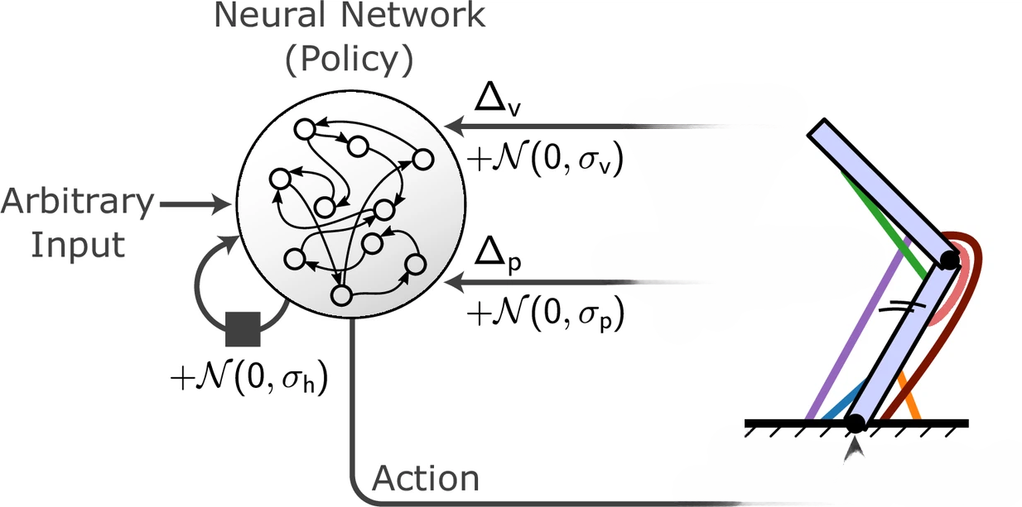
External Force
1 Newton
leftward
NMA Comparing Networks
Notes:
Next, we tested the model’s robustness by applying a constant 1-newton leftward force throughout the trajectory.

Slide 13
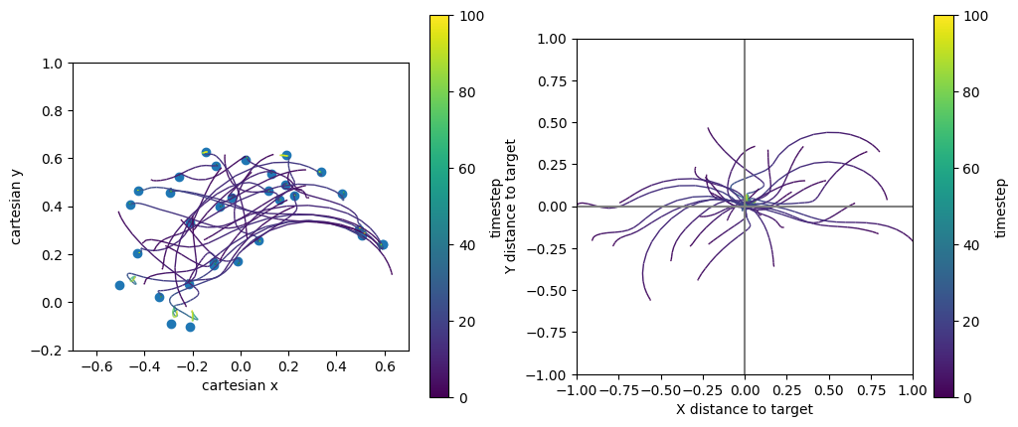
Results & Interpretations
Applied Force to Endpoints & Joints
Even with the disturbance, many trajectories still correct themselves.
Model is adaptive.
NMA Comparing Networks
Page 13/15
Notes:
we see the perturbed fingertip trajectories in Cartesian space. While some paths deviate early, most still curve back toward the target.
This suggests that the GRU-based policy is able to partially compensate for external forces—even though it wasn’t trained with them—highlighting the model’s adaptability.”

Slide 14
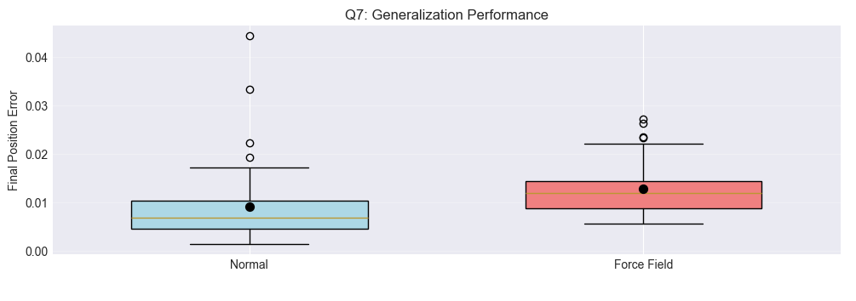
Base model in new environment
================================================
Performance Statistics:
================================================
Normal Environment:
Mean Error: 0.0091 ± 0.0077
Success Rate: 100.0%
Force Field Environment:
Mean Error: 0.0128 ± 0.0053
Success Rate: 100.0%
Performance Degradation: 40.5%
(Note: this is the small baseline model)
Notes:
Performance degradation of 20-40% under novel perturbations is typical
Adaptation occurs both within trials (online) and between trials (offline)
Trajectory compensation strategies emerge without explicit training

Slide 15
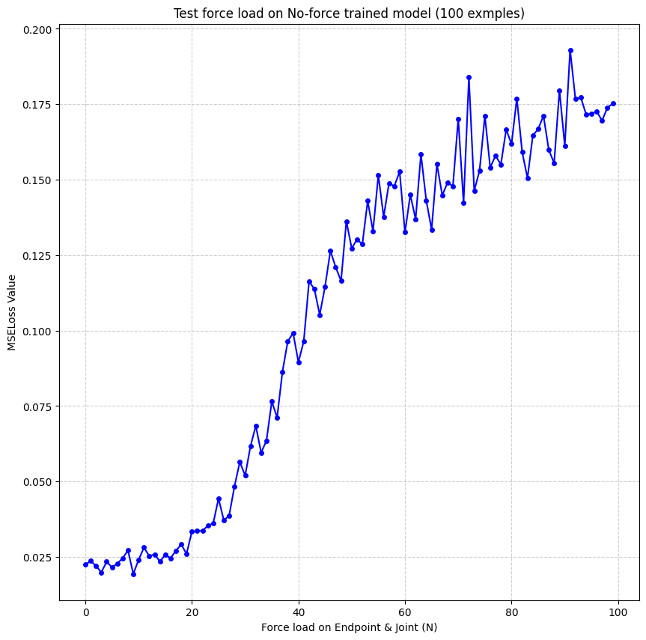
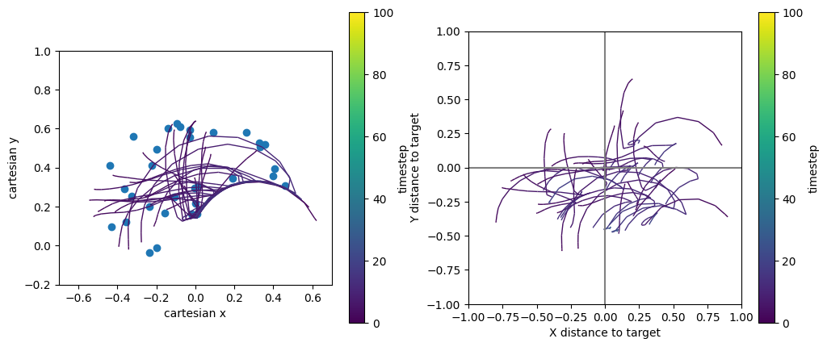
1N Force
Force change resuls
100N Force
Increase of force results in higher loss value!
Model tasks perform worse
NMA Comparing Networks
Page 15/20
Notes:
“To further explore the model’s robustness, we systematically increased the external force from 0 up to 100 newtons.
Each row on the left shows trajectories under increasing force levels—top to bottom, the distortion becomes more severe.
Still, many trajectories continue to bend toward the target, especially under moderate force.
The plot on the right shows a clear trend: as force increases, the final position error grows almost linearly.
This indicates that while the model can tolerate small to moderate disturbances, its accuracy degrades with stronger perturbations—highlighting the limits of generalization in the no-force-trained policy.”

Slide 16
How can we mitigate this?
1 NL
1 NR
NMA Comparing Networks
0.5 ND
Notes:
For question 7, we tested the model’s robustness by applying a constant 1-newton leftward force throughout the trajectory.

Slide 17
Multi Condition Training
Condition | Error | Error | Success Rate (< 0.05)
No Force | Mean: 0.0111 | Std: 0.0087 | 100.00%
1N Left | Mean: 0.0152 | Std: 0.0133 | 95.00%
1N Right | Mean: 0.0122 | Std: 0.0072 | 100.00%
0.5N Down | Mean: 0.0109 | Std: 0.0052 | 100.00%
Training on multiple conditions simultaneously improves generalization to novel perturbations
Notes:
in q7 we saw Performance degradation of 20-40% under novel perturbations is typical
Training on multiple conditions simultaneously improves generalization to novel perturbations
Cross-condition transfer learning reduces training time for new environments
Performance equity across conditions indicates successful general motor learning
Displacement due to force is highest early in the movement and decays over time, indicating the model learns to compensate for external forces as the movement progresses.
"1N Left" shows the largest initial displacement, matching the higher mean error and variability.
============================================================
The model can reach targets under all force conditions, but the paths are more curved or deviated under force perturbations, especially for "1N Left" and "1N Right".
The "No Force" and "0.5N Down" conditions show more direct, efficient trajectories.

Slide 18
Conclusion
We investigated the capability of a Recurrent Neural Network (RNN) to effectively learn strategies for approaching a random target. 💪
We highlighted the conditions under which the model demonstrates successful generalization and identified scenarios where it does not. ✅ ⚠️
One possible strategy to mitigate this is training a multi condition RNN. 💡
Future Scope:
Exploration of diverse environmental setups, hyper-parameter tuning, and experimentation with various model architectures.
NMA Comparing Networks
Page 18/20
Notes:
Condition Input Analysis:
Performance with mismatched condition labels:
Mean error: 0.0199 ± 0.0056
Compare to correct labels: 0.0152
✗ Model may NOT be using condition information effectively
The model may not be using the condition information as effectively as intended.
It may be relying more on general movement strategies than on explicit condition cues.
This could be due to insufficiently strong or distinct condition encoding in the network, or the model learning to “average out” the perturbations.

Slide 19
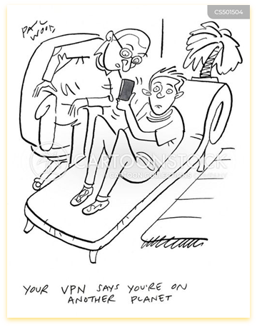
2025
Thank You
Team VPN
for
NeuroAI
@Neuromatch

Slide 20
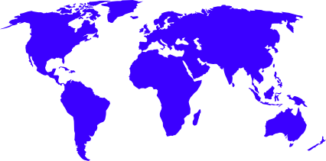
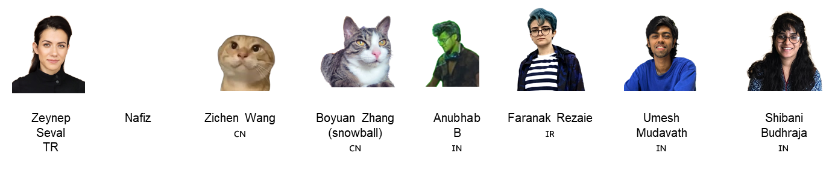
Probing Motor Learning in Embodied Neural Networks
NMA Comparing Networks
Team VPN

